Slide 1
Medical image classification with Convolutional Neural Networks (CNNs)

Slide 2
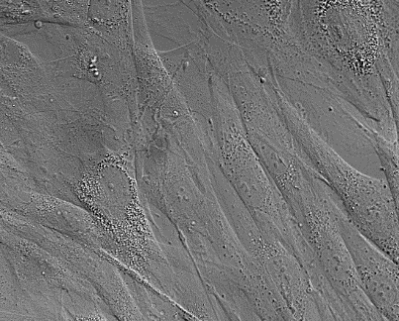
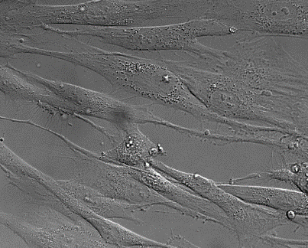
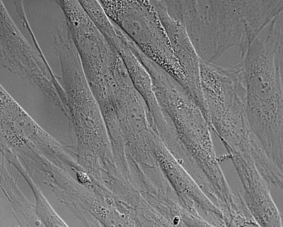
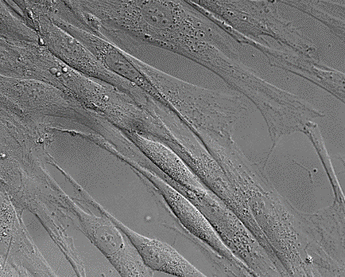
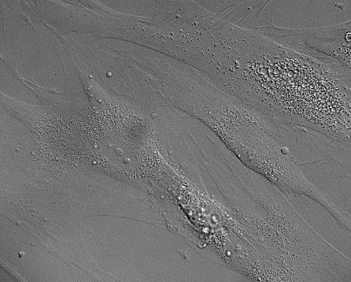
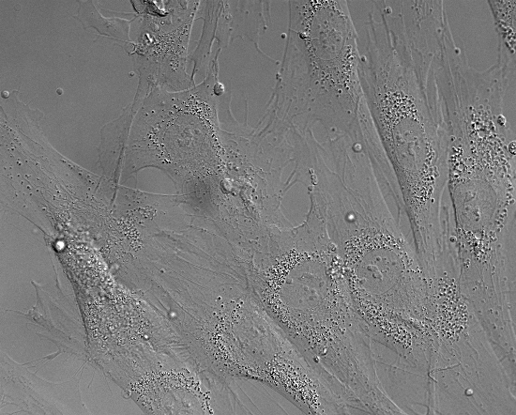
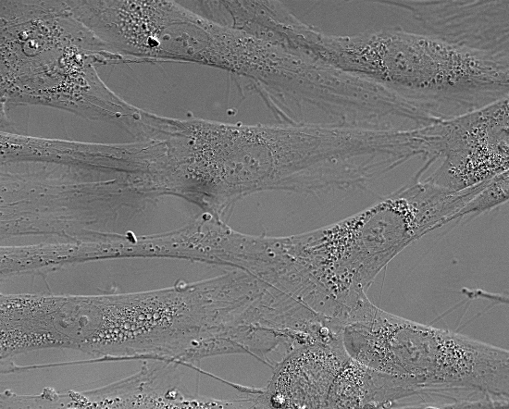
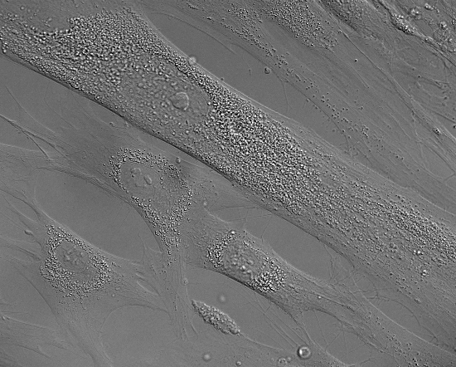
Images for classification
Fibroblasts from CLN7 patients (ko) and healthy relatives (wt)
Cultivated on coated coverslips until a density of 90-100% was reached
Images were performed on a Zeiss Microscope using a 60x (oil) objective and DIC contrast
Images are converted to 6-bit grayscale and are downscaled to 20% (550x442 px) or to 10% (275x221 px) to save VRAM
PS autocontrast applied to all images
Examples (550x442 px):
wt:
ko:

Slide 3
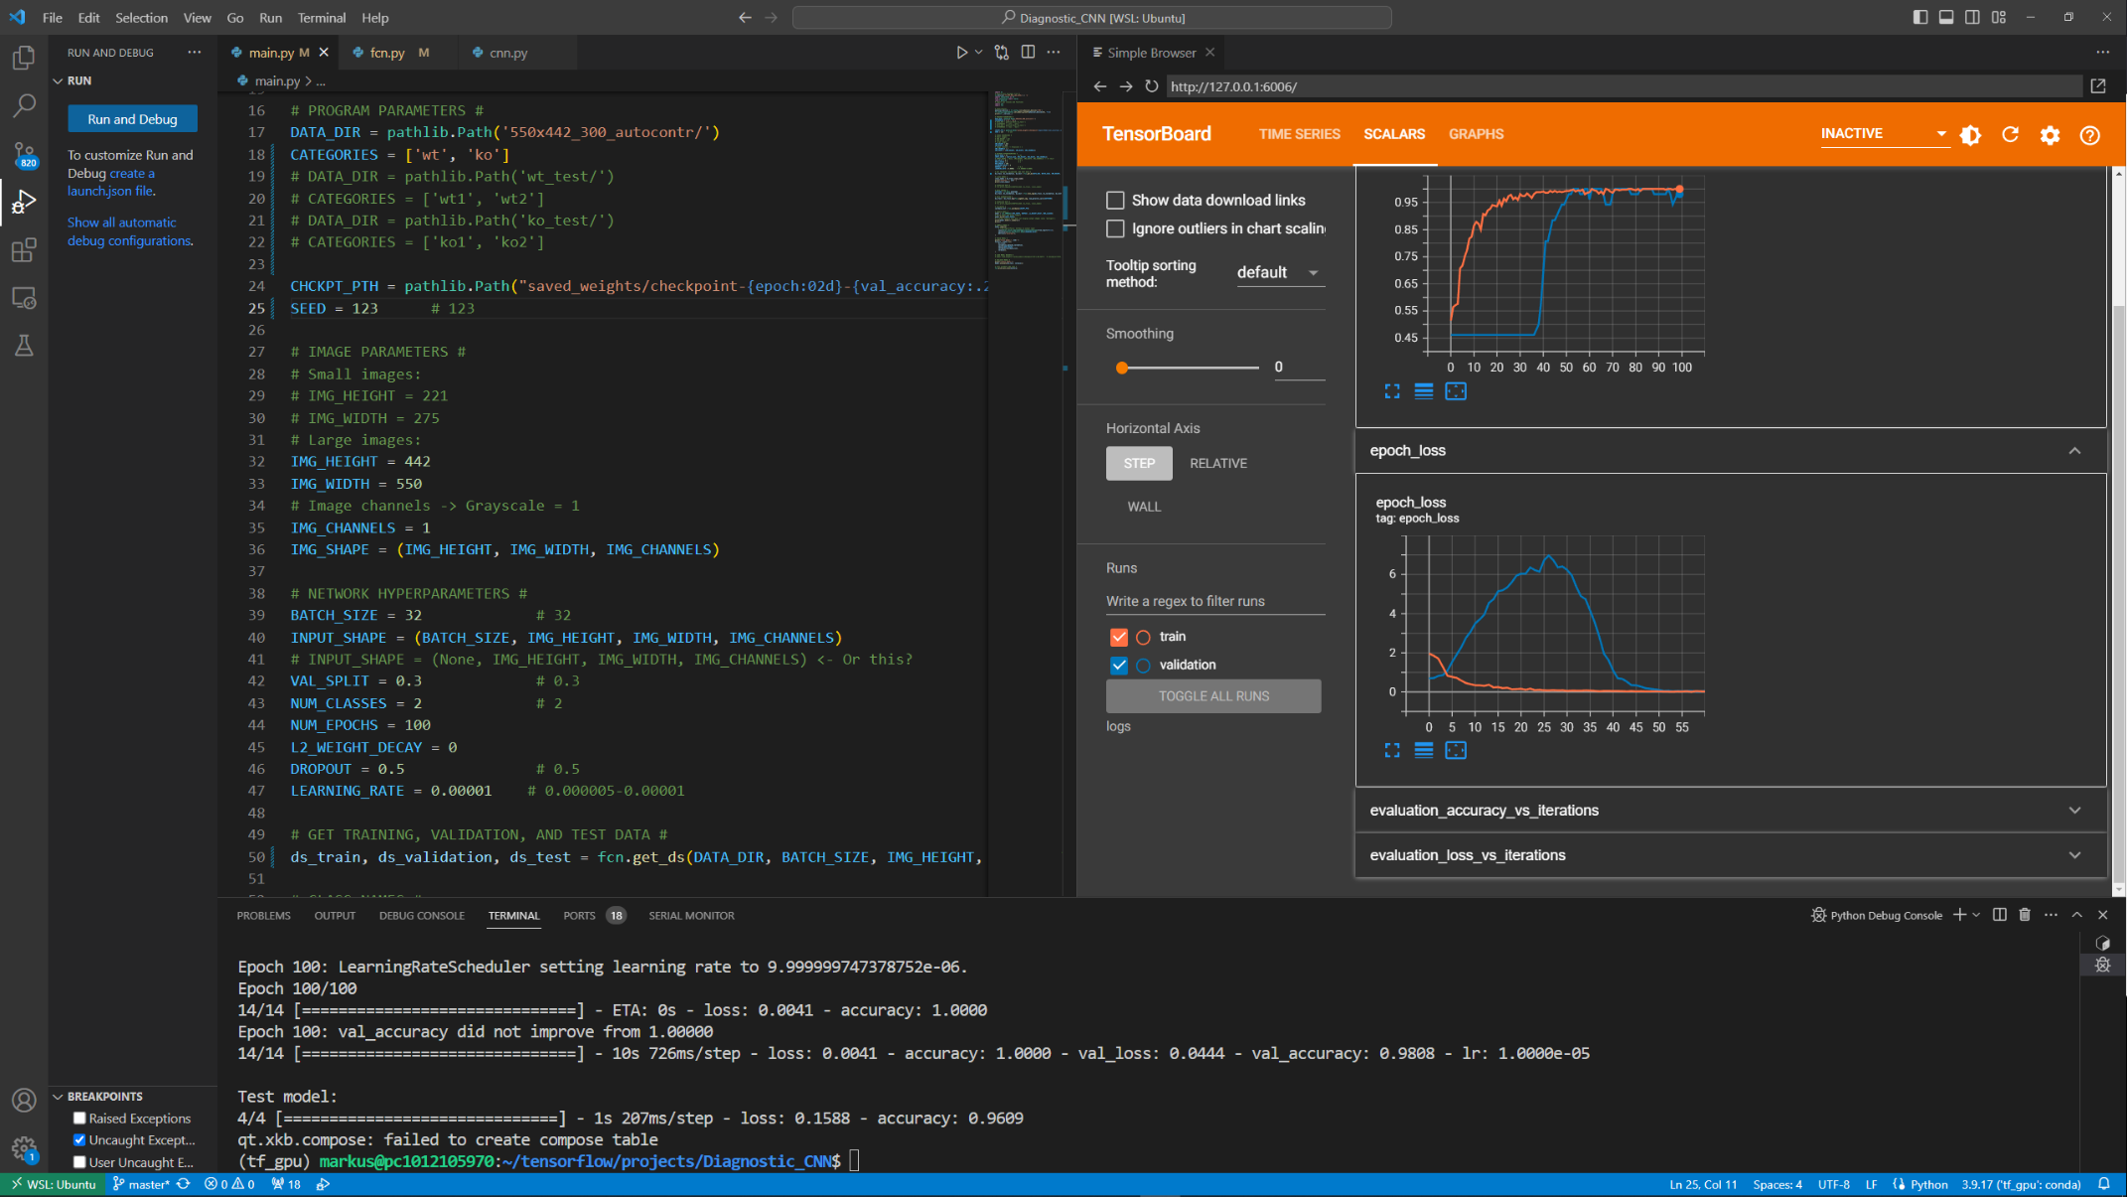
Software
Software: Visual Studio Code (Microsoft)
Written in python using the tensorflow (and keras) library

Slide 4
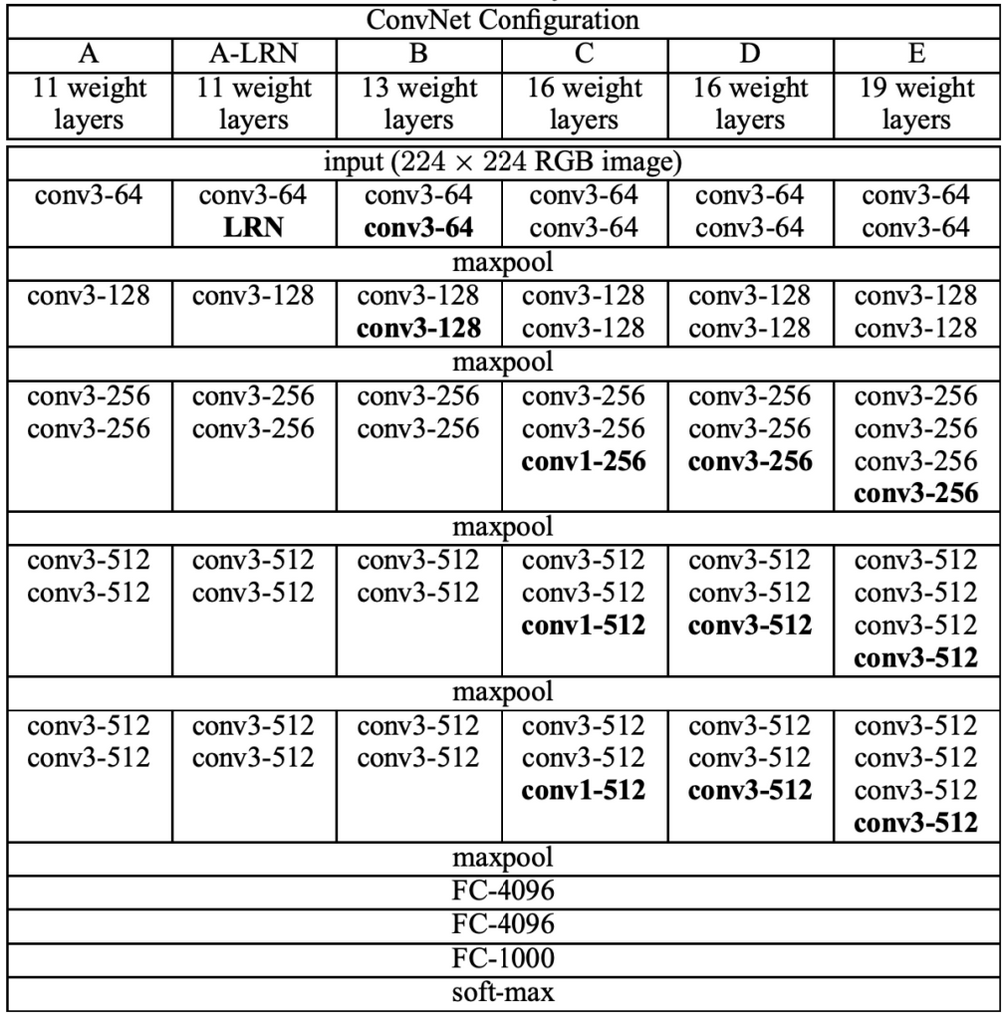
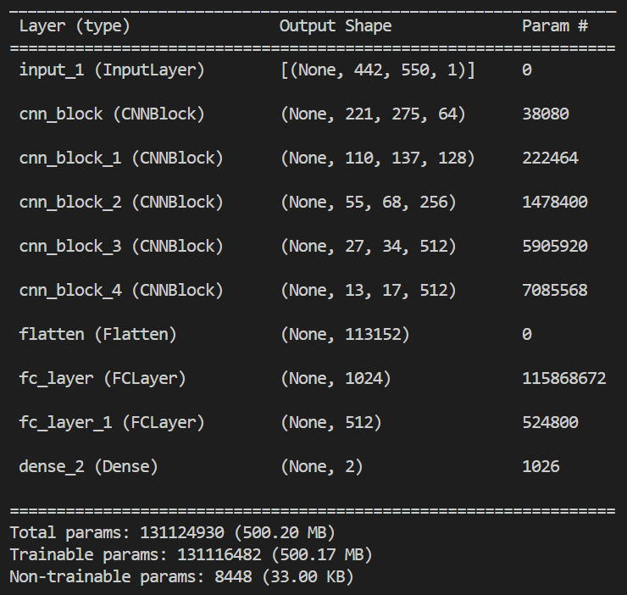
The CNN architecture
VGG-16 like architecture
First described in: K. Simonyan, A. Zisserman; Very Deep Convolutional Networks for Large-Scale Image Recognition; International Conference on Learning Representations, 2015
FC-1024
Architecture E too large for video RAM (Nvidia RTX 3090 with 24 GB VRAM)
FC-512
FC-2

Slide 5
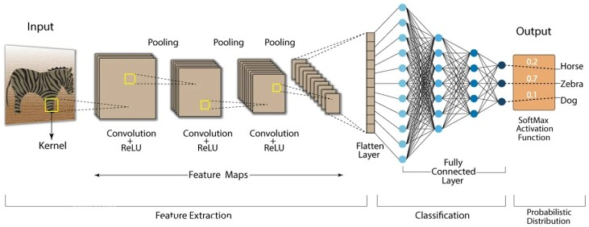
Features and Regularization
Features:
Activation function in all layers: ReLU
CNN layers: Kernel size: 3x3, stride: 1, padding: same
Pooling layers: 2x2 pooling, stride: 2, max pooling
Classifier: 2 nodes (wt and ko) with softmax activation function
131,116,482 (500.17 MB) trainable parameters
Regularization:
Batch normalization after each CNN layer
Dropout of 50% in the first two fully connected layers
Optional L2 regularization possible, but currently not used

Slide 6

Data preparation and augmentation
Data preparation:
Batch size: 32
Split data in three groups of batches: - Training dataset (70%) - Validation dataset (10%) - Test dataset (20%)
Shuffling of data (dependent on seed)
Normalization of gray values 0-255 to range 0-1
Data augmentation:
Flip images randomly left/right
Flip images randomly up/down

Slide 7
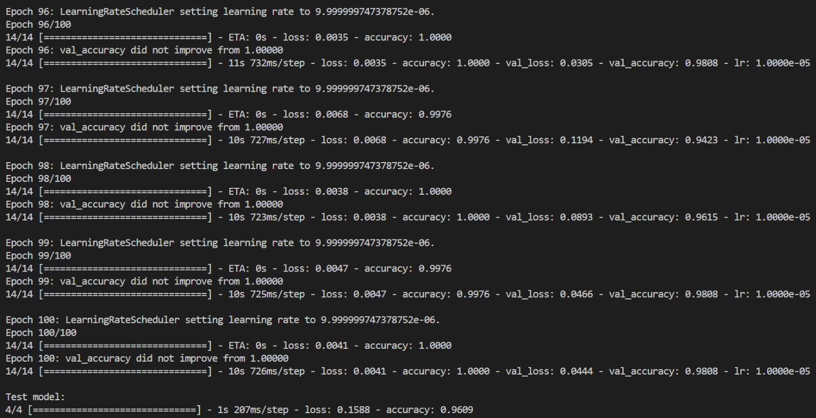
Training
Max 100 epochs
Early stopping (keras.callbacks.EarlyStopping): patience 20, monitor: validation accuracy
Learning rate scheduler (keras.callbacks.ReduceLROnPlateau): epoch 1-59: 1e-5, 60-69: 1e-6, 70-79: 1e-7, 80-100: 1e-8
Saves the model weights with an validation accuracy > 98% automatically (keras.callbacks.ModelCheckpoint)
Monitoring of test loss/accuracy and validation loss/accuracy with tensorboard during training (keras.callbacks.TensorBoard)
Evaluation of the model with the test dataset after training (loss/accuracy)
epoch 96-100 (without
early stopping) and test of the model at the end of the training

Slide 8
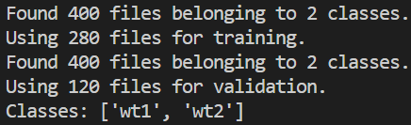
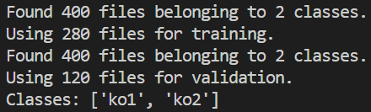
Preliminary testing
Results dependent on seed (random validation and test split)
For testing the network only one dish of one CLN7 patient and one dish of one healthy person were used so far
Pictures were done using the stitching function of the microscope
Pictures were excluded when: - dirt or dead cells were present - no or only a few cells were on the image
Pictures were excluded to get about the same cell density (not in future experiments)
Tests: - wt vs. ko (300 images each: 420 training, 60 validation, 120 testing) - wt vs. wt (200 images each: 280 training, 40 validation, 80 testing) - ko vs. ko (200 images each : 280 training, 40 validation, 80 testing)
Every second picture was taken for separating wt1 vs. wt2 and ko1 vs. ko2 to avoid local differences in the cell density (not the first and the second half of the images as they are all from one side of the slide)
No early stopping! 100 epochs

Slide 9
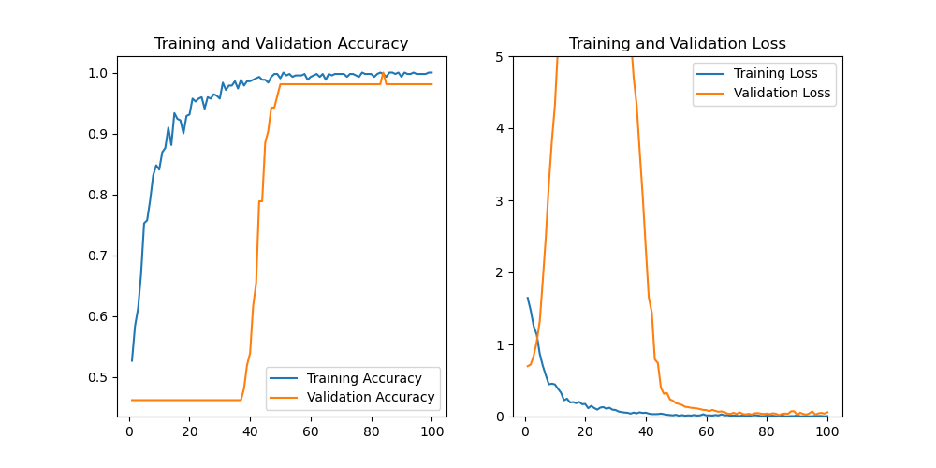
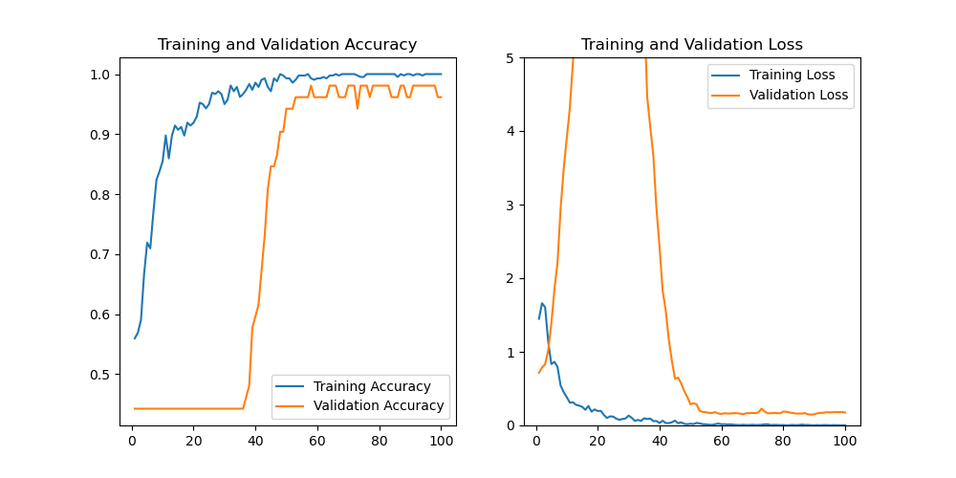
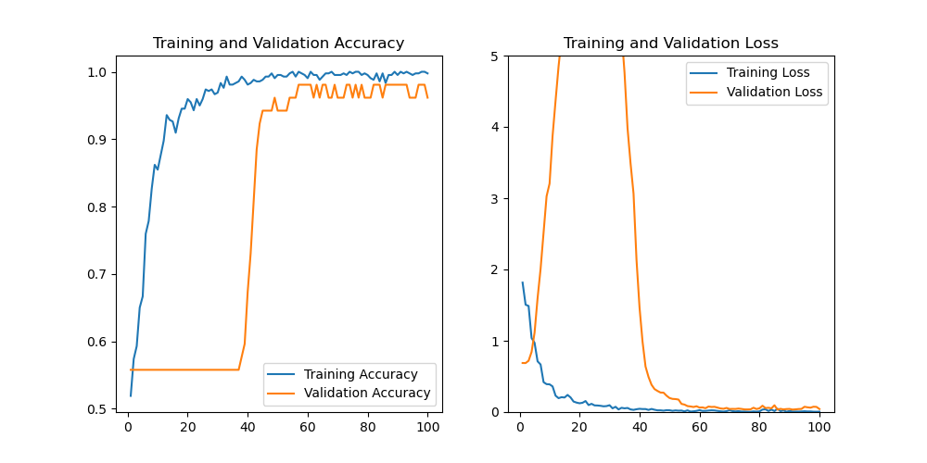
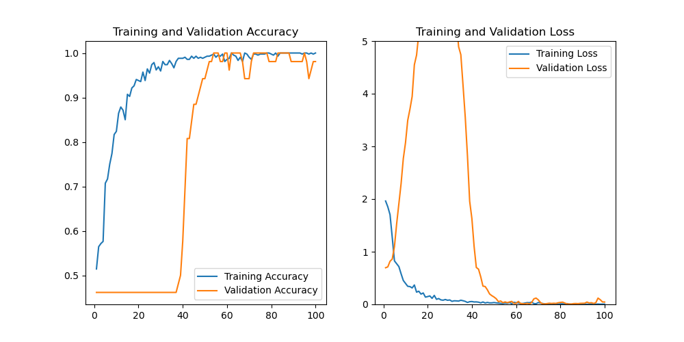
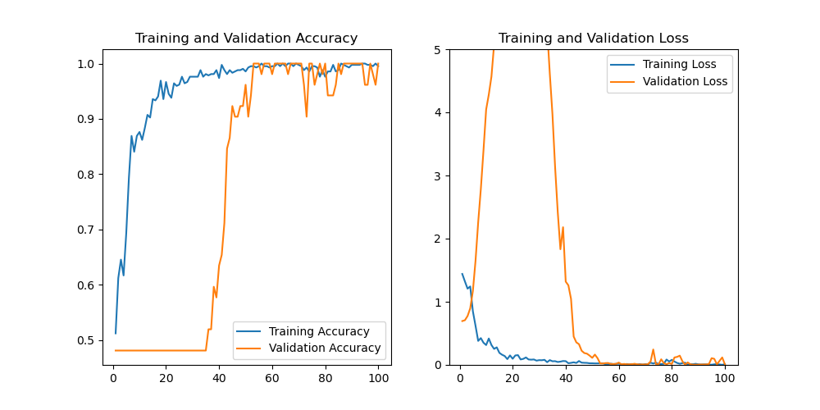
WT vs. KO
seed 222
acc: 96%
seed 444
acc: 97%
seed 333
acc: 96%
seed 123
acc: 100%
seed 111
acc: 97%
Experiments were performed without early stopping and without learning rate scheduler with a constant lr of 0.00001

Slide 10
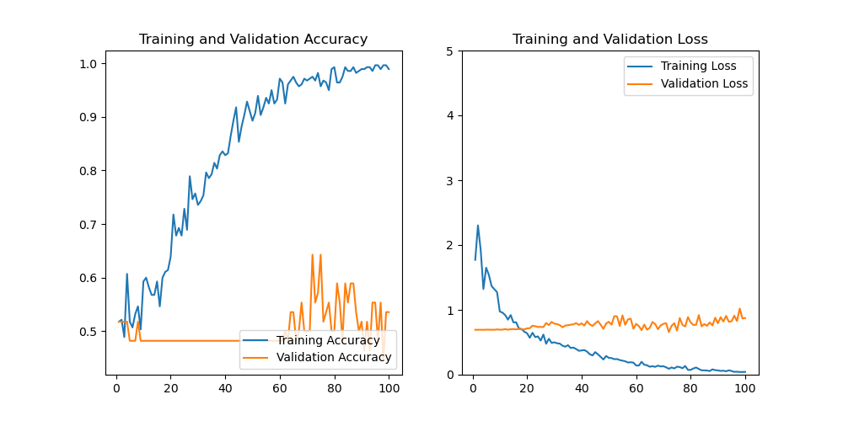
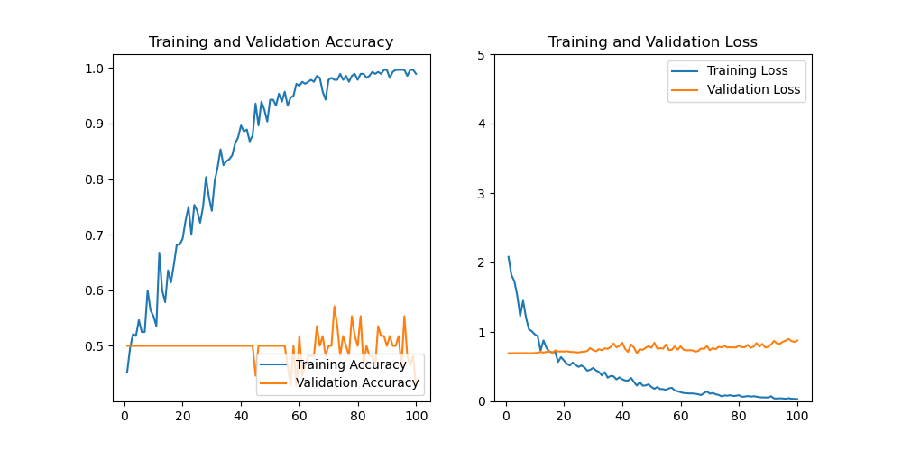
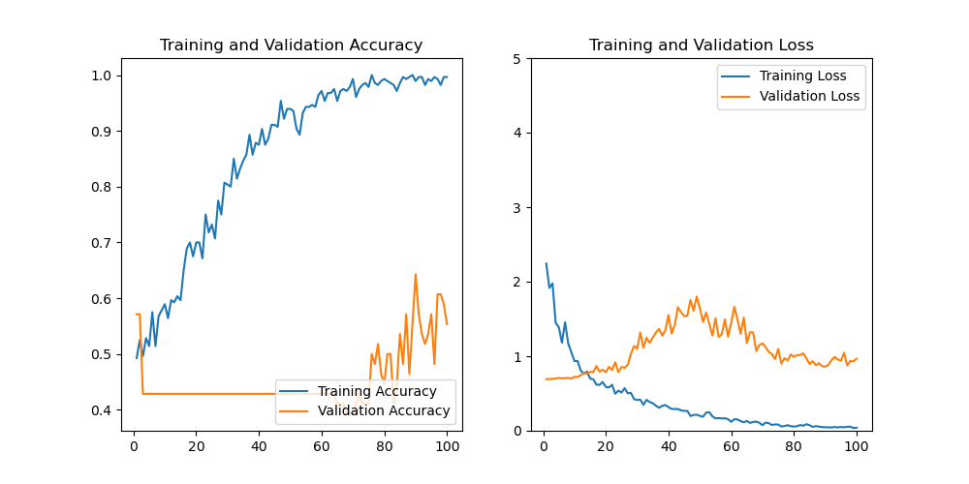
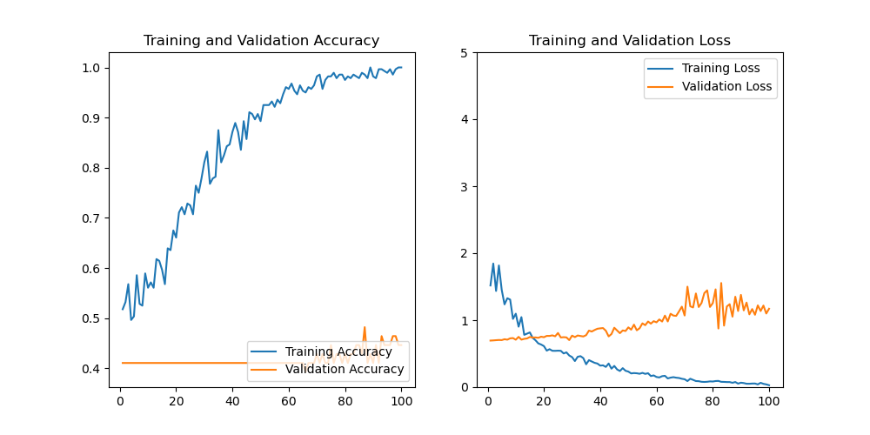
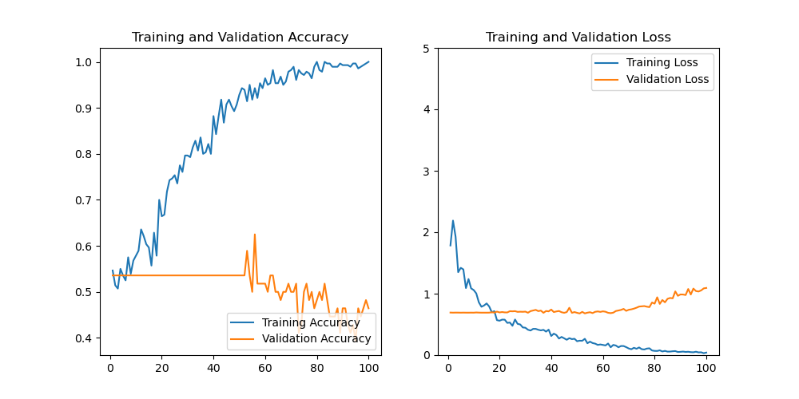
WT1 vs. WT2
seed 222
acc: 45%
seed 444
acc: 41%
seed 333
acc: 53%
seed 123
acc: 32%
seed 111
acc: 53%
Experiments were performed without early stopping and without learning rate scheduler with a constant lr of 0.00001

Slide 11
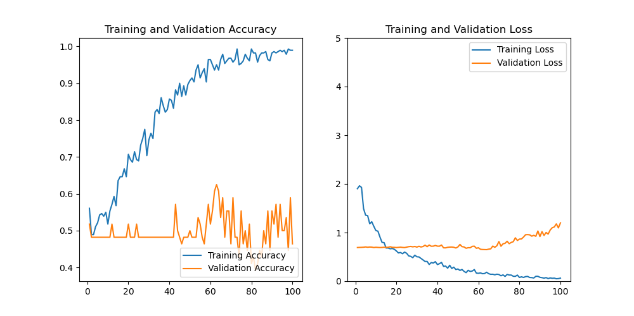
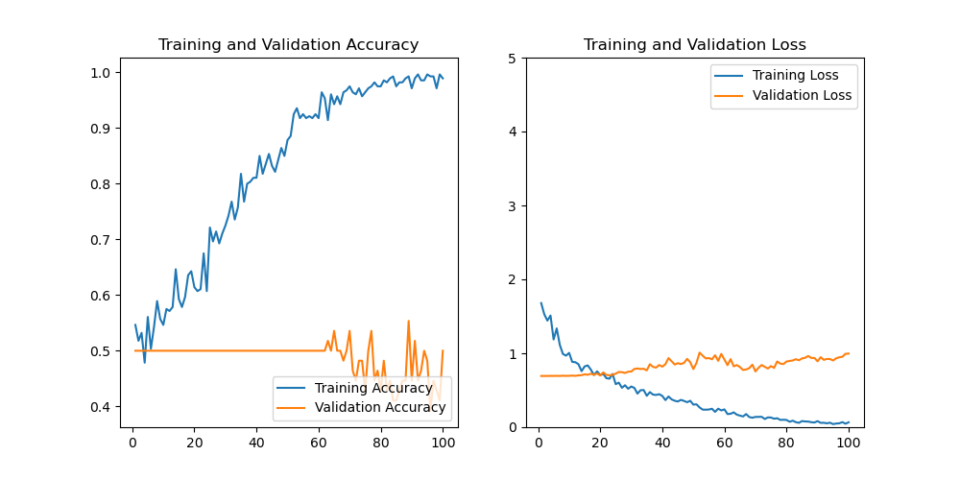
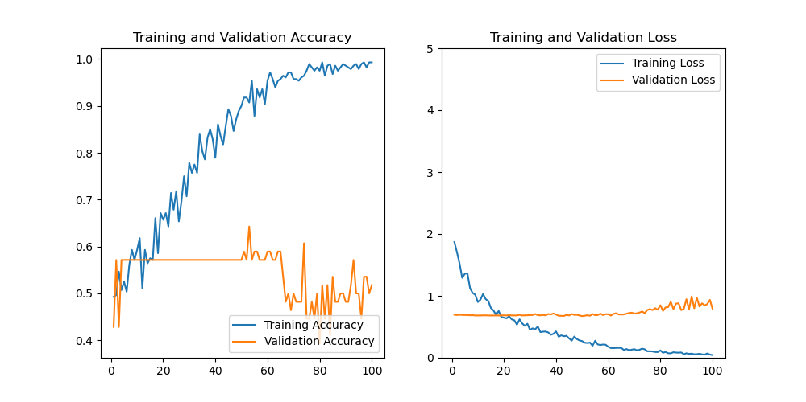
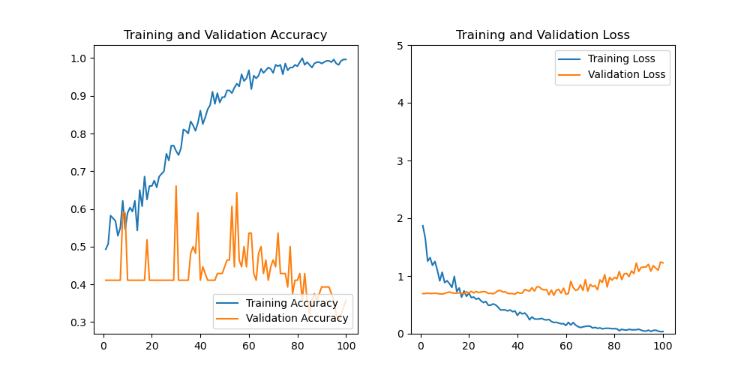
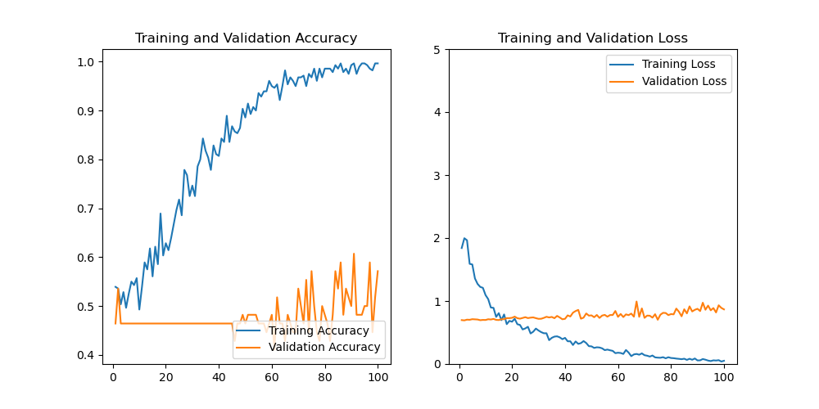
KO1 vs. KO2
seed 222
acc: 42%
seed 444
acc: 53%
seed 333
acc: 58%
seed 123
acc: 32%
seed 111
acc: 48%
Experiments were performed without early stopping and without learning rate scheduler with a constant lr of 0.00001

